Slide 1
Word Nest
A Modern Dictionary Application

Slide 2
Our Team
23501A05I1(T.Sudheshna Devi)
23501A05D5(P.Nandini)
24505A0513(N.Bhagya Sri)
23501A05J4(Y.Nihar)
23501A05J2(Y.Bhashitha)
23501A05H4(T.Anu)

Slide 3
Introduction
In today's digital world, quick access to information is essential. Word Nest offers a streamlined and user-friendly dictionary application for students and language learners, enhancing their vocabulary learning and language proficiency.

Slide 4
Problem Statement
In the fast-paced digital age, language learners and students often struggle to find a centralized, easy-to-use platform that not only provides accurate word meanings but also offers pronunciation, usage examples, and vocabulary-building tools. Existing online dictionaries can be cluttered, lack personalization, or miss essential features for effective learning. There is a clear need for a responsive, visually engaging, and educational dictionary application tailored especially for students and non-native speakers to support their language development journey.

Slide 5
Objectives of the Project
Design a dictionary application providing accurate meanings, synonyms, antonyms, and example sentences. Include additional features like pronunciation support and a 'word-of-the-day'. Aim for a responsive user interface for ease of use, particularly for students and non-native speakers.

Slide 6
Scope and Relevance
The application is relevant academically and practically, supporting e-learning and vocabulary building. Demonstrates critical programming skills, data handling, and UI design in Computer Science. Scalable with potential future features such as offline access and multi-language support.

Slide 7
Software Used
HTML for web page structure and content. CSS for modern styling and user interface. JavaScript for dynamic interactions and API requests. Local Storage for user signup information persistence.

Slide 8
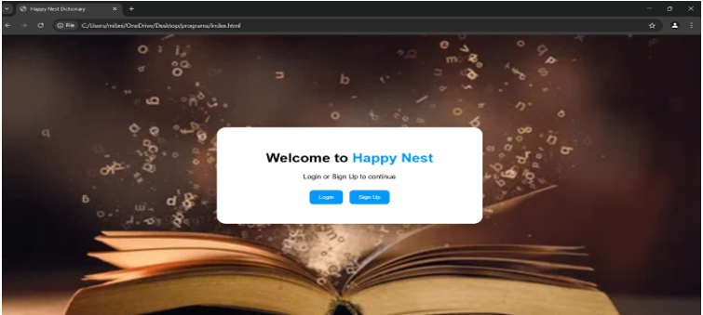
PROTOTYPE MODEL
“While developing the screen,we use some main tags
<img> — for the React logo icon.
<h1> — for the heading "Hello! Welcome to Happy Nest”
.<span> — to color only "Happy Nest" differently (blue).
<button> — for the "Next" button.
<body> — to apply the background image (the open book)

Slide 9
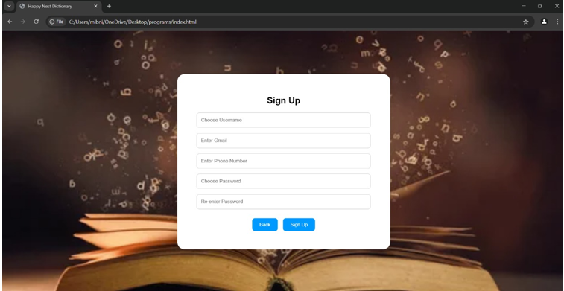
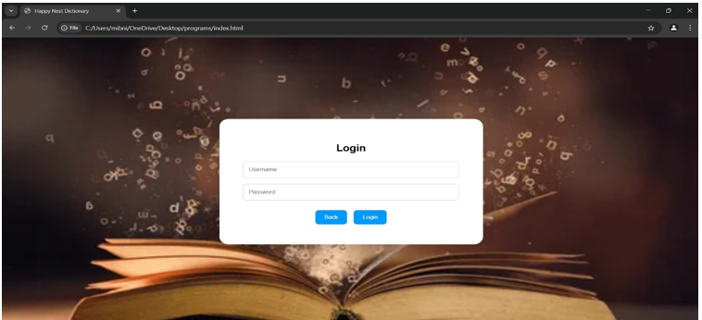
.
<form> — around the search input and button.
<input> — for the search bar (where you type a word)
<p> — for the part of speech (noun), pronunciation, and definitions.
<button> — for the "Next" button.
<body> — to apply the background image (the open book)

Slide 10
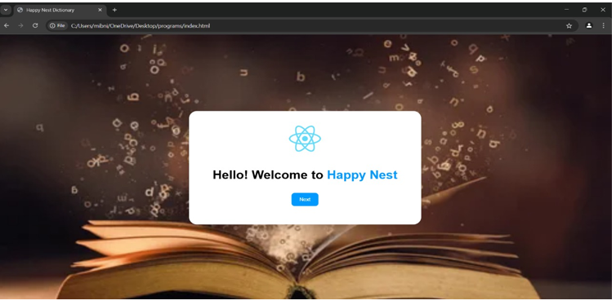
.
CSS / Style-wise (not tags, but important for how it looks):
background-image — the open book
box-shadow — for the white card pop-up effect.
border-radius — for rounded corners.
text-align: center — to center the content.color — to color part of the text (like "Happy Nest" in blue).
flexbox (display: flex) — to center align elements.

Slide 11
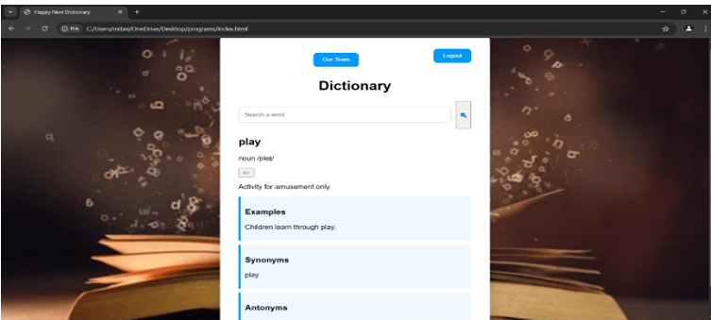
.
<div> — to structure the layout (cards, sections).
<header> — to place the "Our Team" and "Logout" buttons.
<form> — around the search input and button.
<input> — for the search bar (where you type a word).
<button> — for the search icon button.
<p> — for the part of speech (noun), pronunciation, and definitions.
<audio> + <button> — for the small speaker icon to hear the pronunciation.
<section> — for Examples, Synonyms, and Antonyms sections.
<strong> or <b> — to bold "Examples," "Synonyms," and "Antonyms" titles inside
sections.

Slide 12
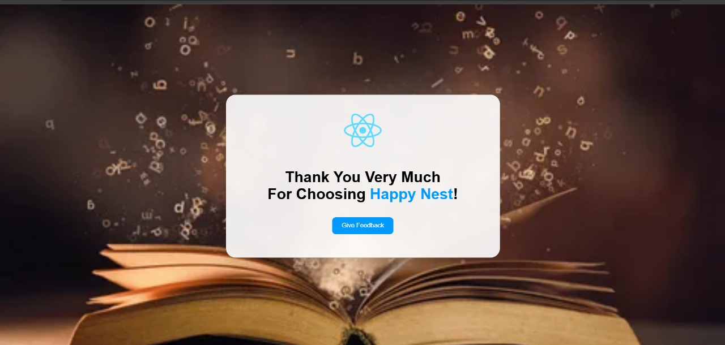
.
<div> → Again for the main container
<img> → (optional) if the React logo is added via an image tag
<h2> or <h1> → For the big "Thank You Very Much For Choosing Happy Nest!" text
<span> → For styling specific parts like "Happy Nest" in a different color
<button> → For the "Give Feedback" button

Slide 13
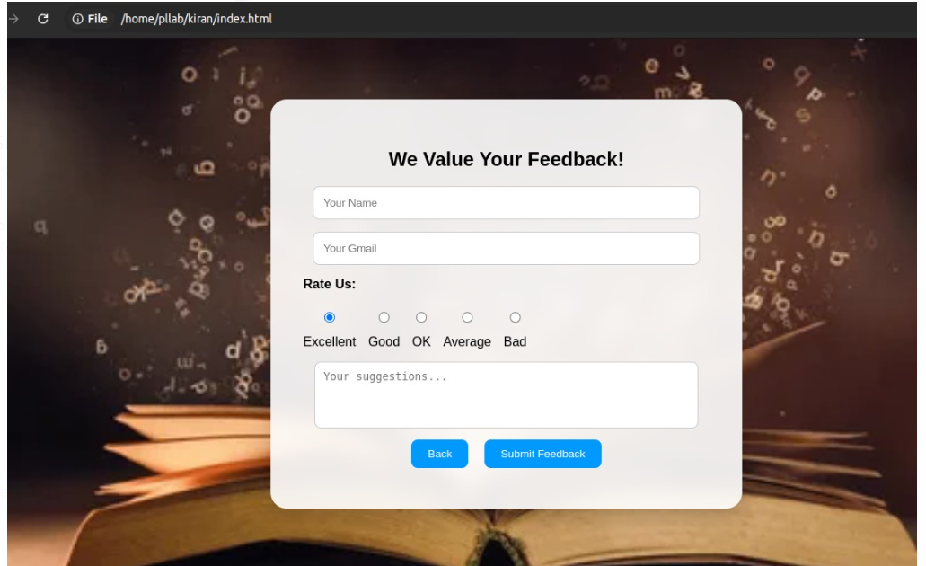
.
<div> → For the overall card (the white box) and inner layout divisions
<h2> → For "We Value Your Feedback!" heading
<form> → To wrap the entire feedback form (inputs, ratings, textarea, buttons)
<input type="text"> → For "Your Name" field
<input type="email"> → For "Your Gmail" field<p> → For the label "Rate Us:“
<input type="radio"> → For each rating option (Excellent, Good, OK, Average, Bad)
<label> → For each text next to the radio buttons
<textarea> → For the "Your suggestions..." box<button type="button"> → "Back" button
<button type="submit"> → For the "Submit Feedback" button

Slide 14
Conclusion
Word Nest enhances language learning through an interactive and accessible dictionary platform. By integrating modern design and essential features, it aims to motivate users in vocabulary expansion while bridging the gap between traditional dictionaries and digital tools.

Slide 15
References
GitHub Repository: https://github.com/nihar5776/Dictionary-webpage
HTML Introduction: https://www.w3schools.com/html/html_intro.asp
CSS Introduction: https://www.w3schools.com/css/css_intro.asp
JavaScript Introduction: https://www.w3schools.com/js/default.asp

Slide 16
Thank you!
Do you have any questions? www.yourwebsite.com @yourusername

